Slide 1
Coding Collaboratively with GitHub
Things needed today:
python_practice.py [last class]
Open github.com & log in
Dr. Groves
Dr. Peirce-Cottler
Module 0 Lecture 2
Learning objective: I know how to upload my code to GitHub, pull code from my partner, comment my code for future use, and write code reproducibly.

Slide 2

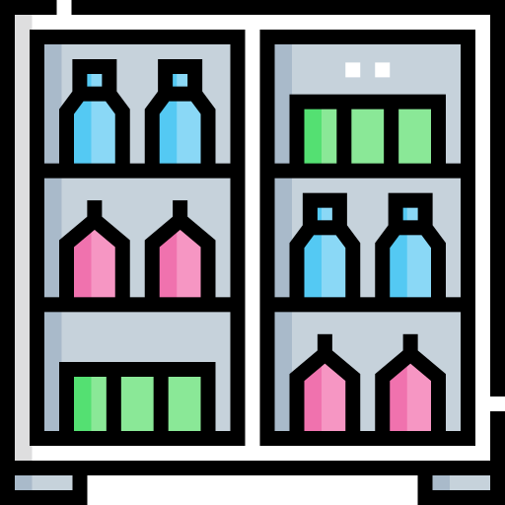




The Restaurant: The Big Picture
Anaconda
How could we share recipes with other restaurants?
Packages
Code
Local Folder
Terminal
Python
The Restaurant (VS Code/IDE)
Conda environments

Slide 3
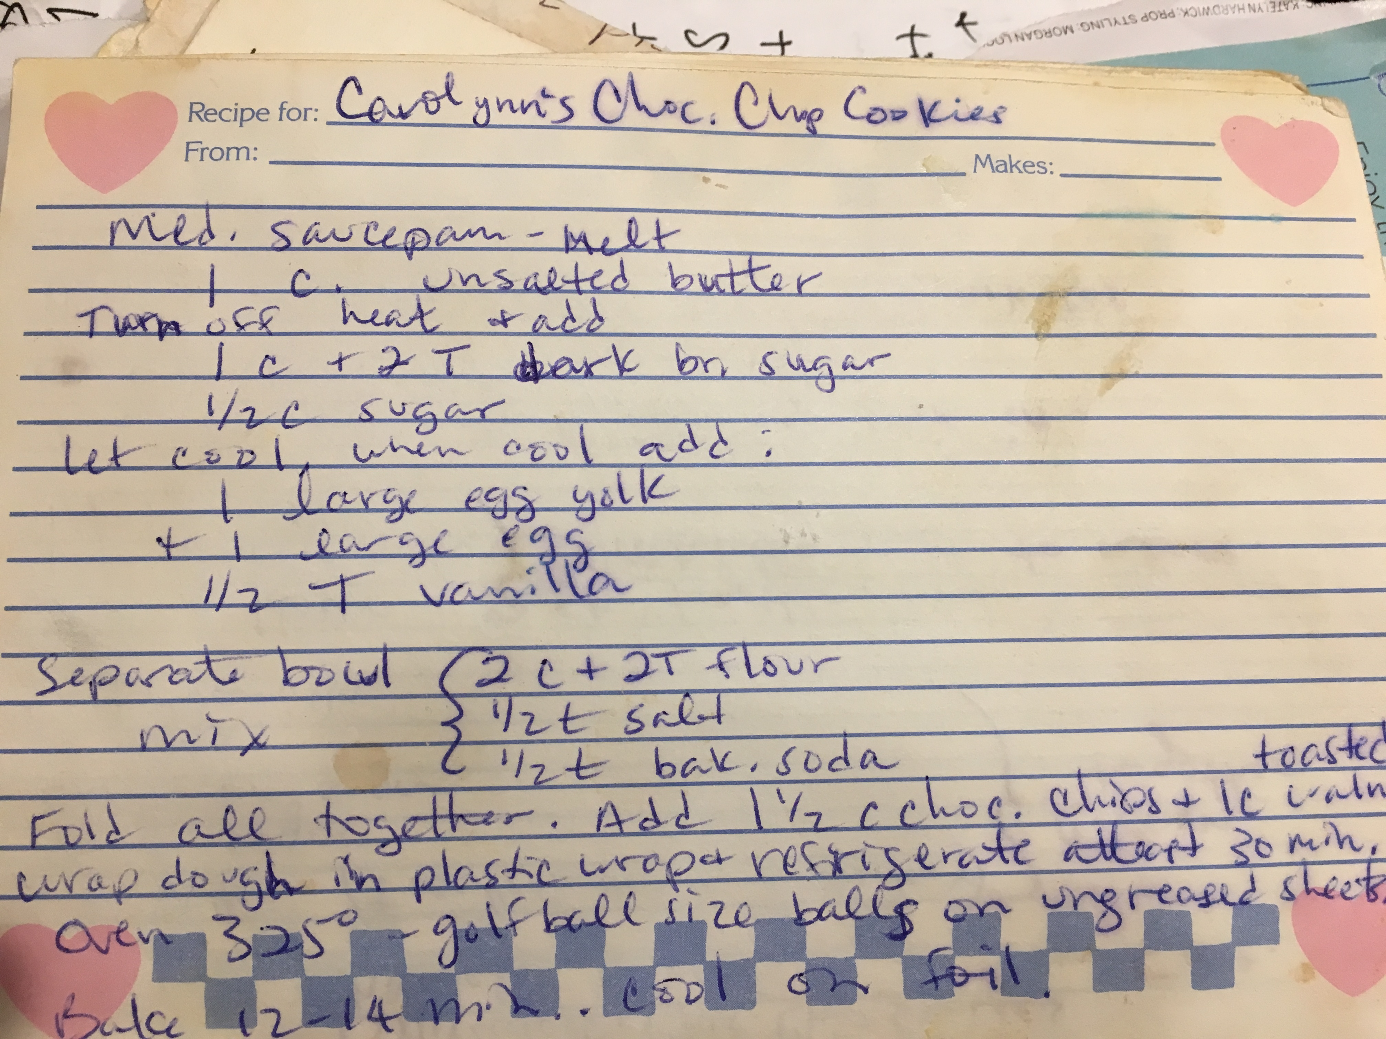
We could share recipes by…
Telling them face to face
Good when you don’t want to share a secret recipe
Bad for coding
Handing them a copy or a picture
What if it’s hard to read?
What if they want to update the recipe and send it back?
What if they want to see multiple iterations of the recipe (did they recipe-test?)
Typing up the recipe and sending them the most recent version and past versions with notes about why things changed
Does the butter have to be completely melted?
Can I add more vanilla?

Slide 4
Outside the restaurant: sharing recipes
How do we contribute to the shared recipe book online?
Get a local copy of the shared recipe book (“clone”)
Make changes (“commit”)
Add these changes back to the remote book (“push”)
Regularly check if anyone else made changes to the shared book (“pull”)
If someone made conflicting changes, figure out how to combine them (“merge”)
Shared recipe book online (“remote”)
Code
Local Folder
Code
Local Folder
The Restaurant (VS Code/IDE)
Another Restaurant

Slide 5
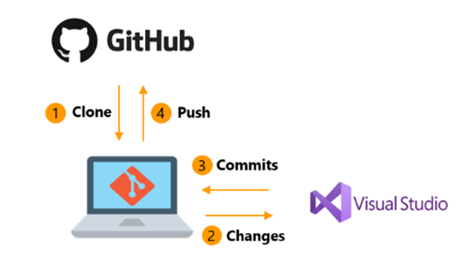
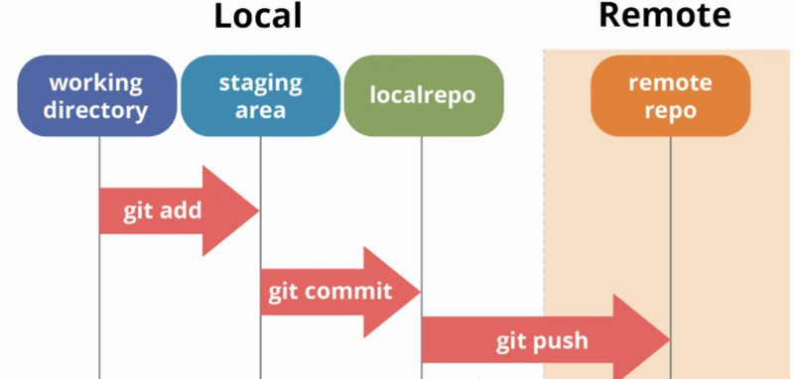
This is how GitHub works
Github hosts your code, git is the version control system
In this class, we will use GitHub to share code (with partners and instructors), code collaboratively, and track changes
Remote, shared
The “commit” process
Local, individual
https://livablesoftware.com/development-process-in-github-basic-infographic/

Slide 6
GitHub Repositories
Entirely different recipe books
In this class, we will use (shared) repositories for each project
Module 1
Module 2
Module 3
Module 4

Slide 7



GitHub Branches
Different remote versions of the same shared book
In this class, we will use branches for individual work within a shared project (starting with Module 1)
branch3
branch2
branch1
Main/master: default branch alias
Origin: “remote” alias
Shared recipe book online (“remote”)
Local Folder
Local Folder
The Restaurant
Another Restaurant

Slide 8
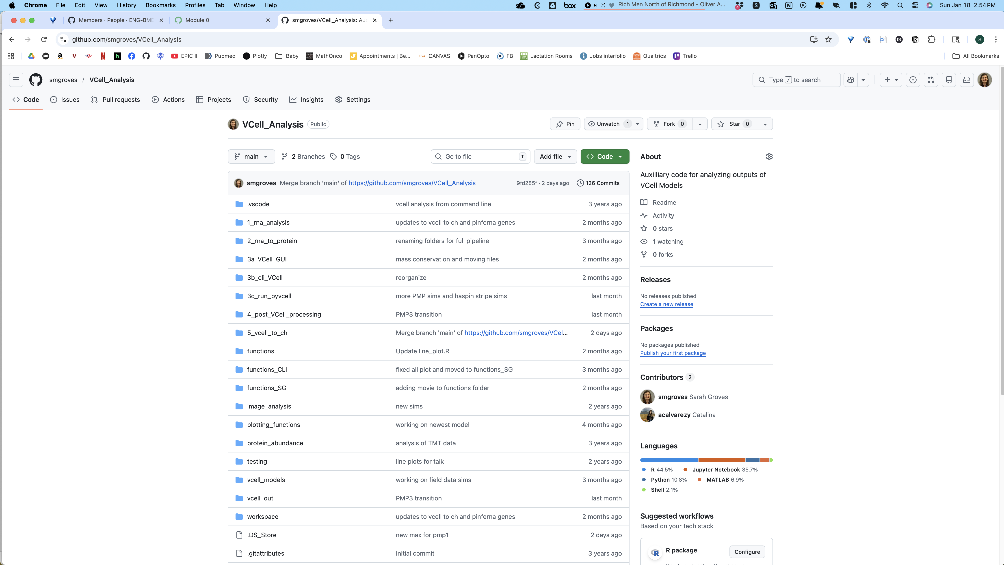
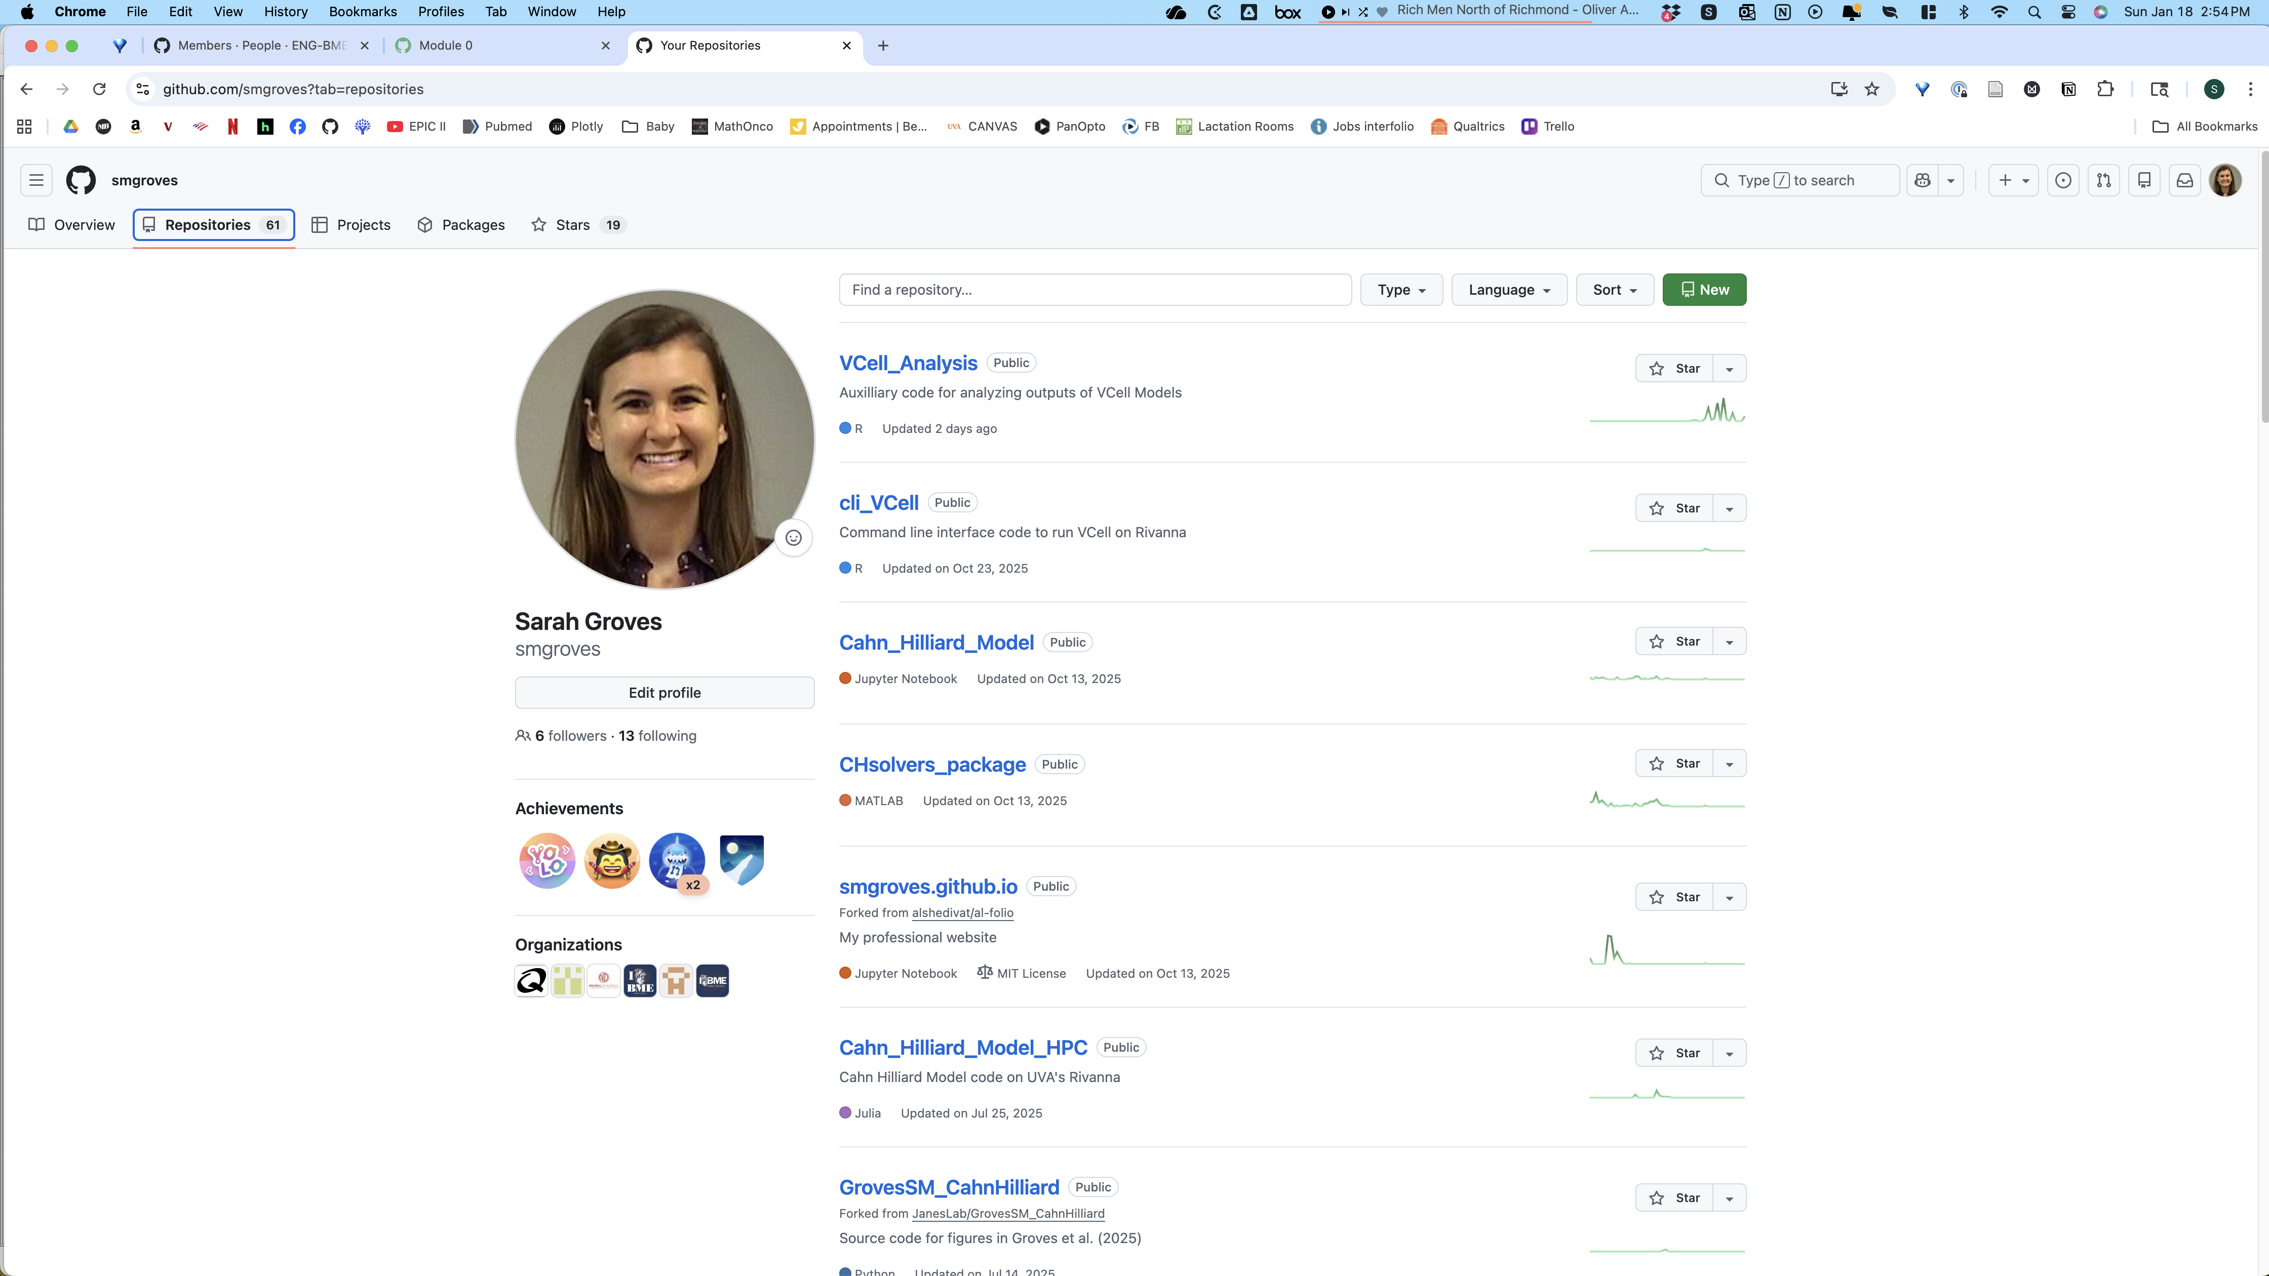
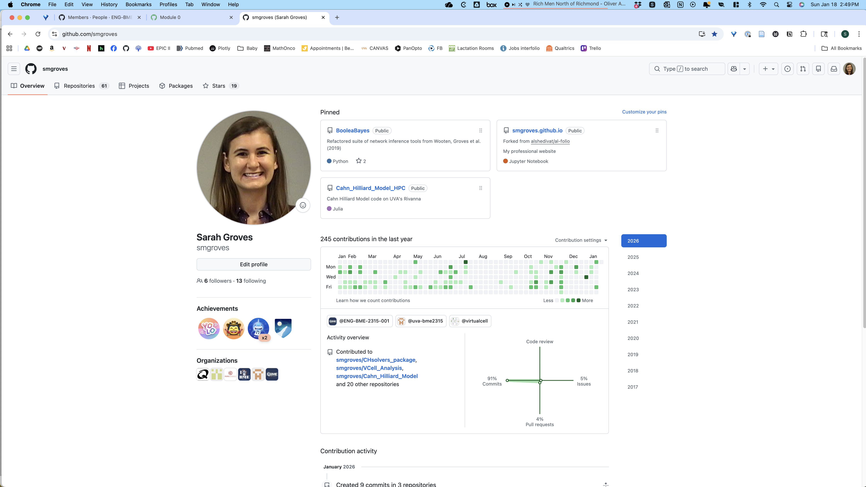
GitHub (remote, online)
Pinned repositories
Settings is in this menu
Full list of your repos
Full list of repos
Download the code or clone repo
Current branch
Most recent commit
Looks like the folder structure on your local computer
Organizations you have joined

Slide 9
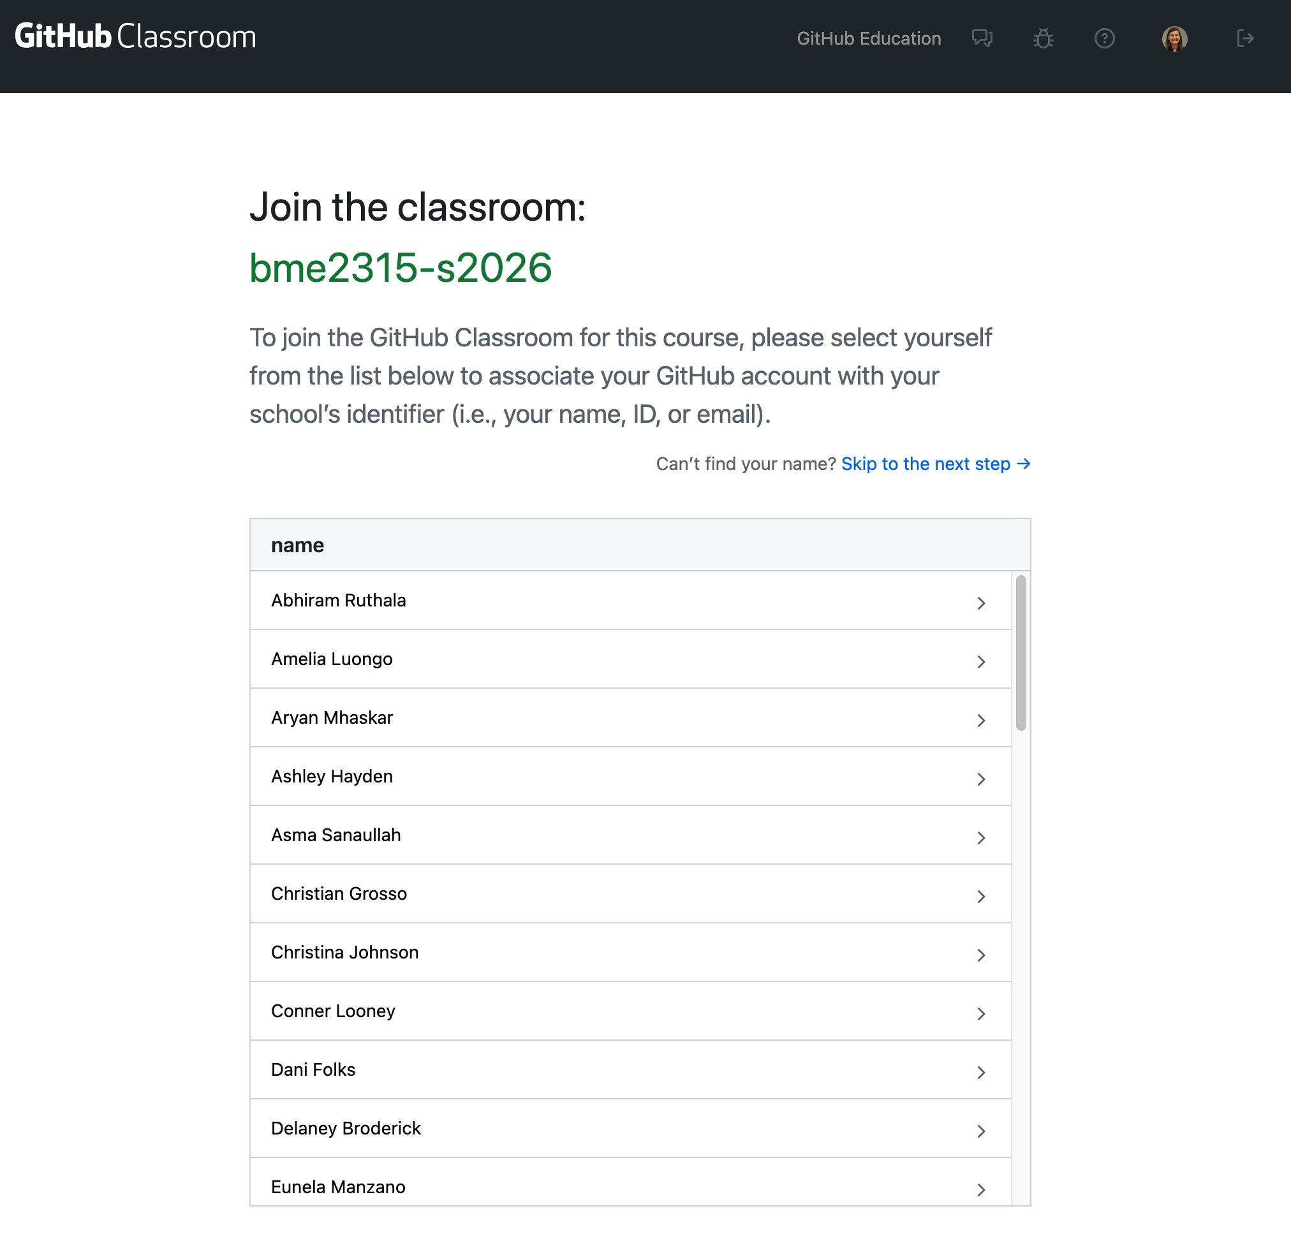
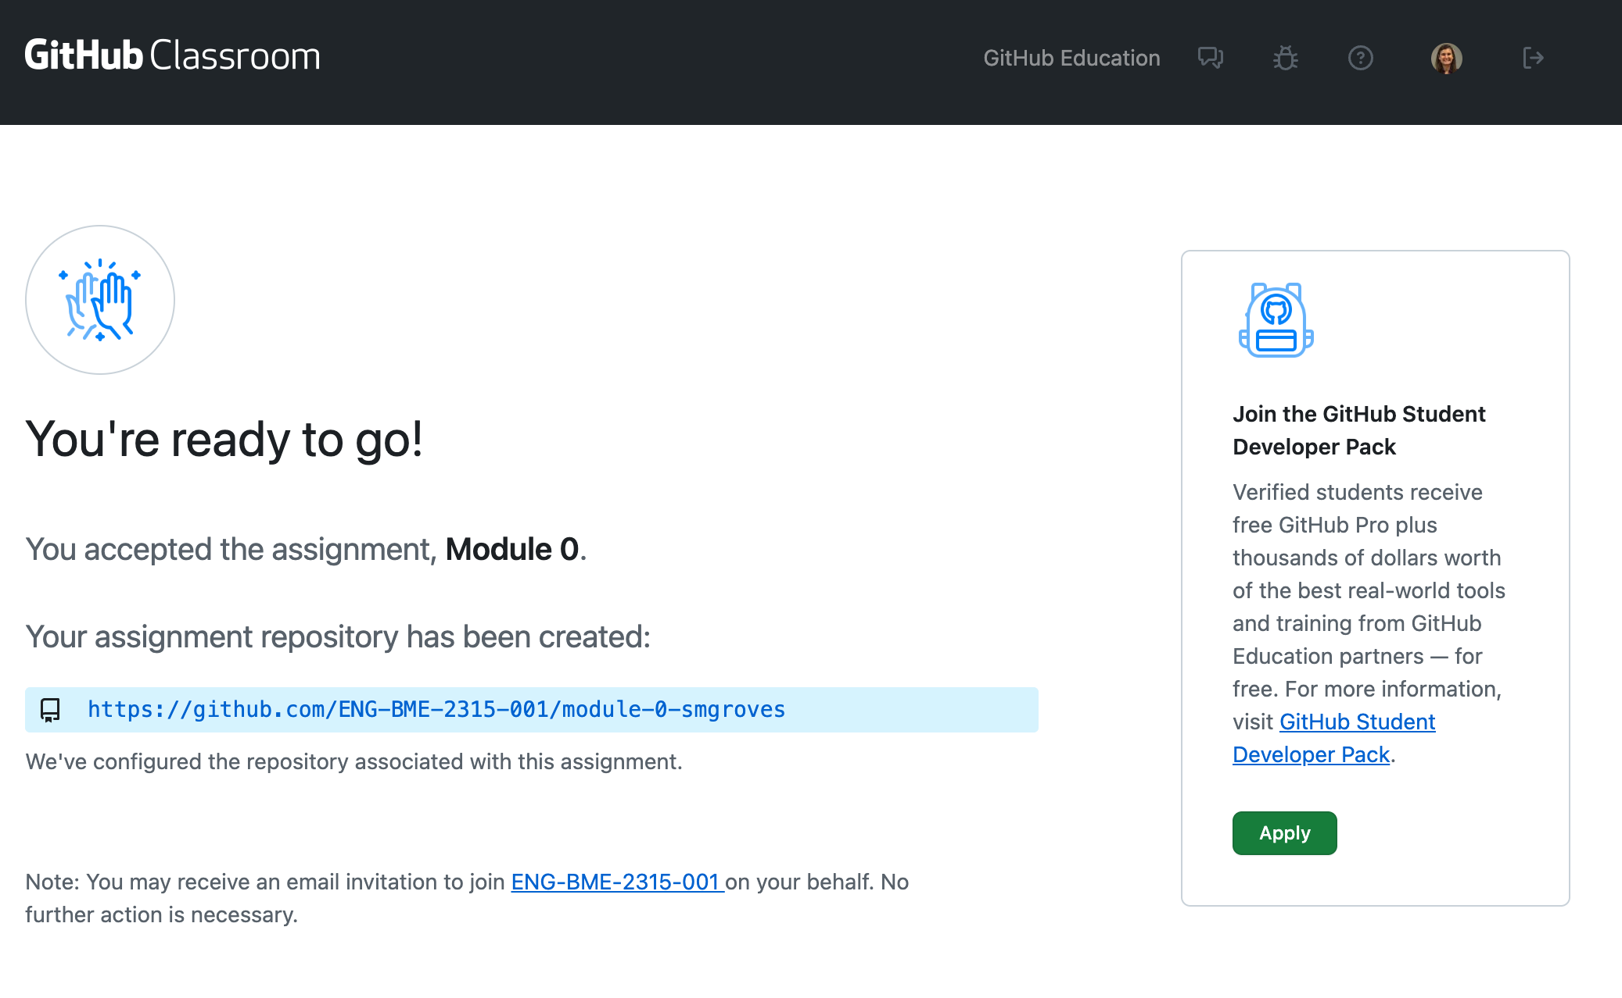
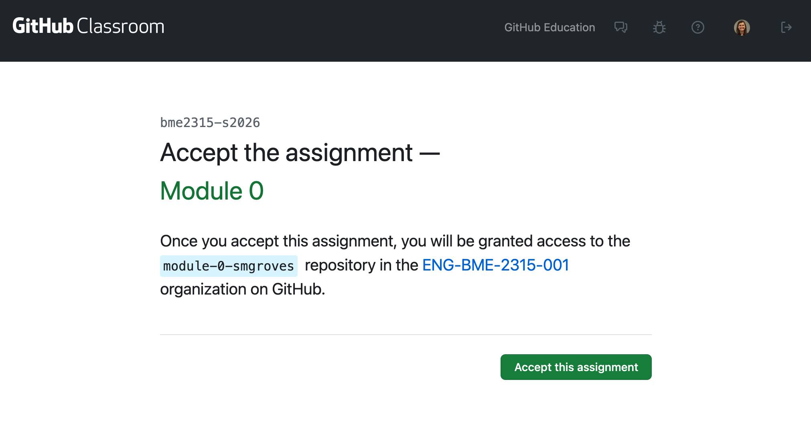
https://classroom.github.com/a/PHAtZR-G

Slide 10
LET’S PRACTICE! Getting set up with GitHub Classroom
You should have a github account.
Join ENG-BME-2315-001 organization (from email). This will show up on your page under “Organizations”
Go to https://classroom.github.com/a/PHAtZR-G & find your name in the roster.
Accept Module_0 assignment (it should add your github username)
Find your repository by going to the ENG-BME-2315-001 organization (on your homepage) and click on the repository named “Module_0_ YourUserName” corresponding to your name.
Clone the repo to your local computer
Fetch origin/main
Open in VS Code
Update README, save, and push changes to the main branch
Stand your name card on its edge when you are done.
Help your neighbors!
If you need a TA/instructor, raise your hand!
Notes:
https://serverspace.us/support/help/git-pull-fetch-and-clone-whats-the-difference/

Slide 11
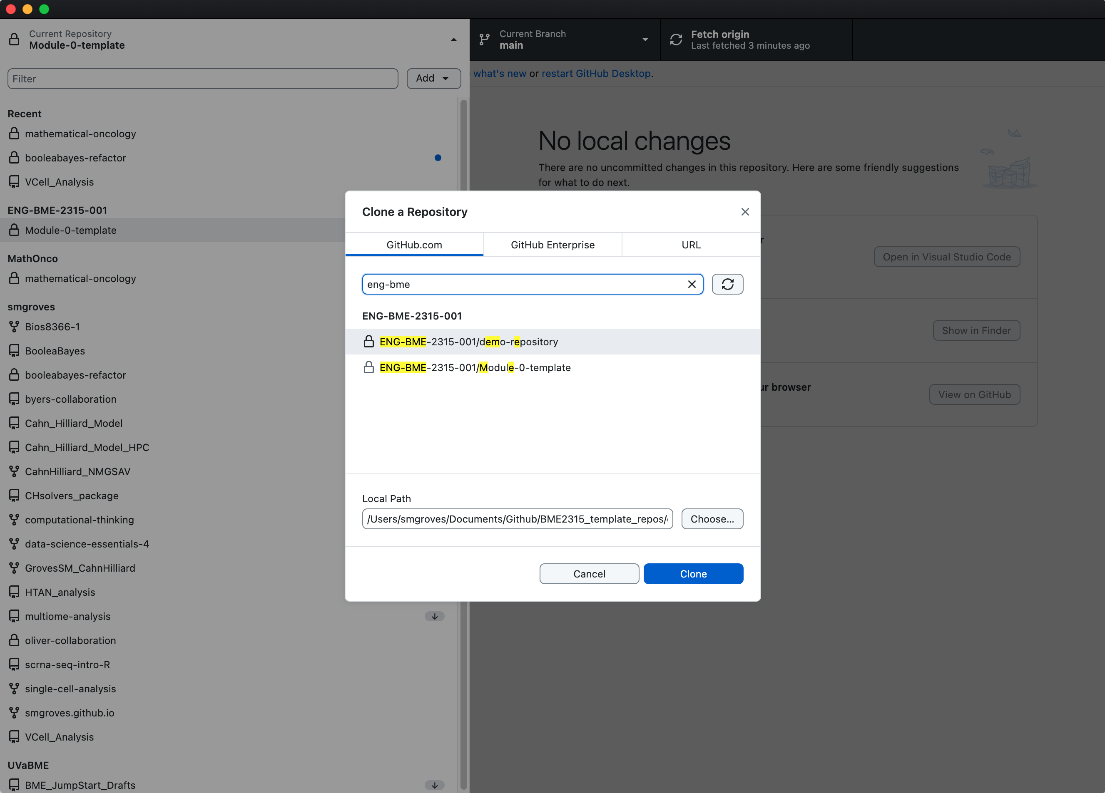
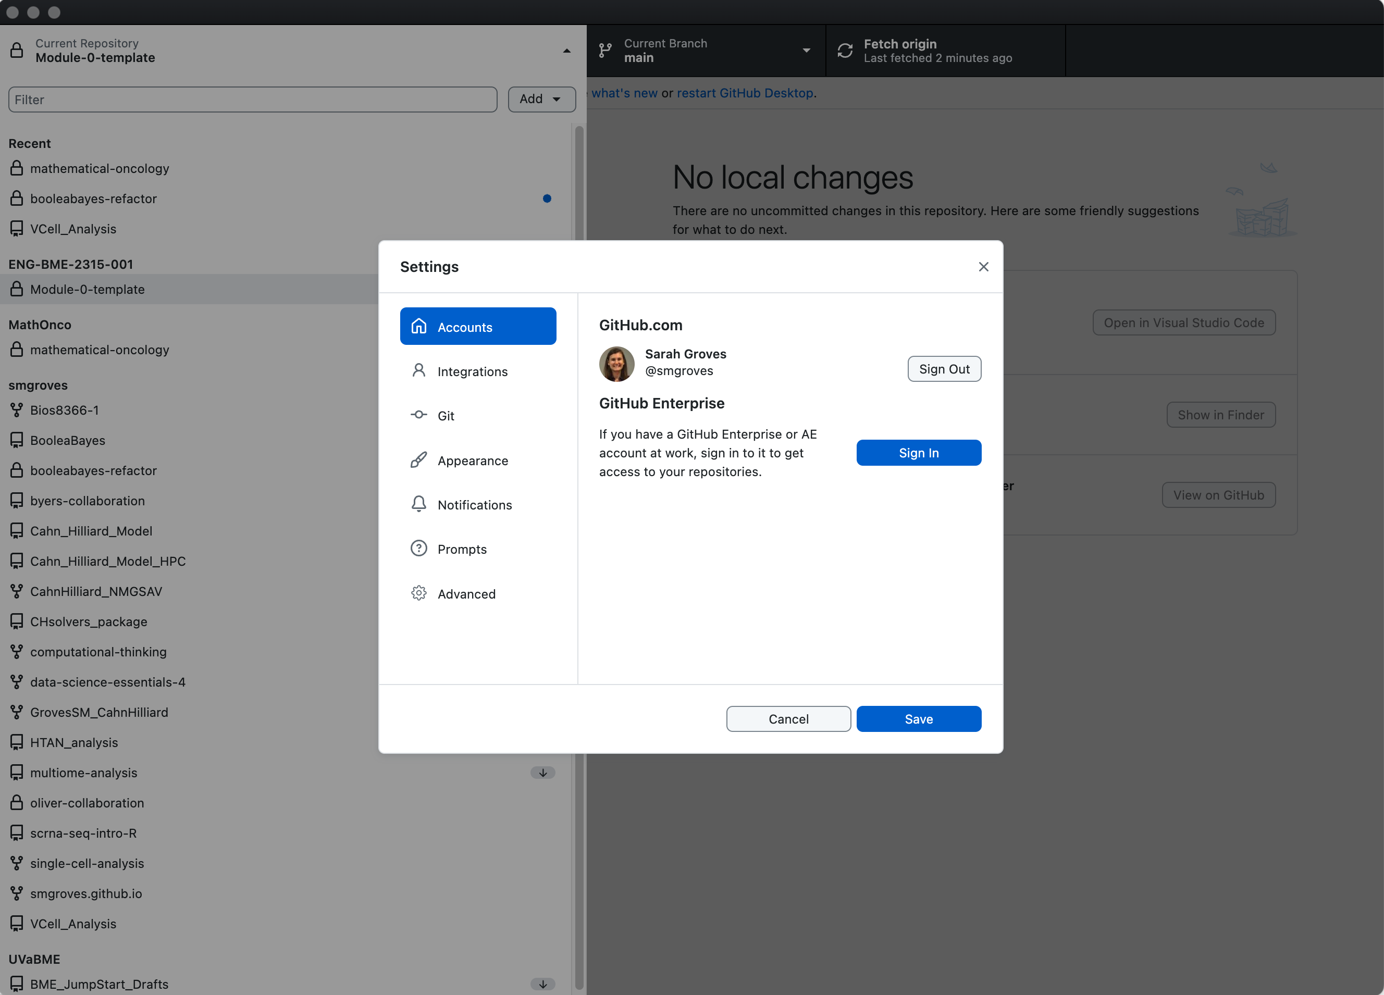
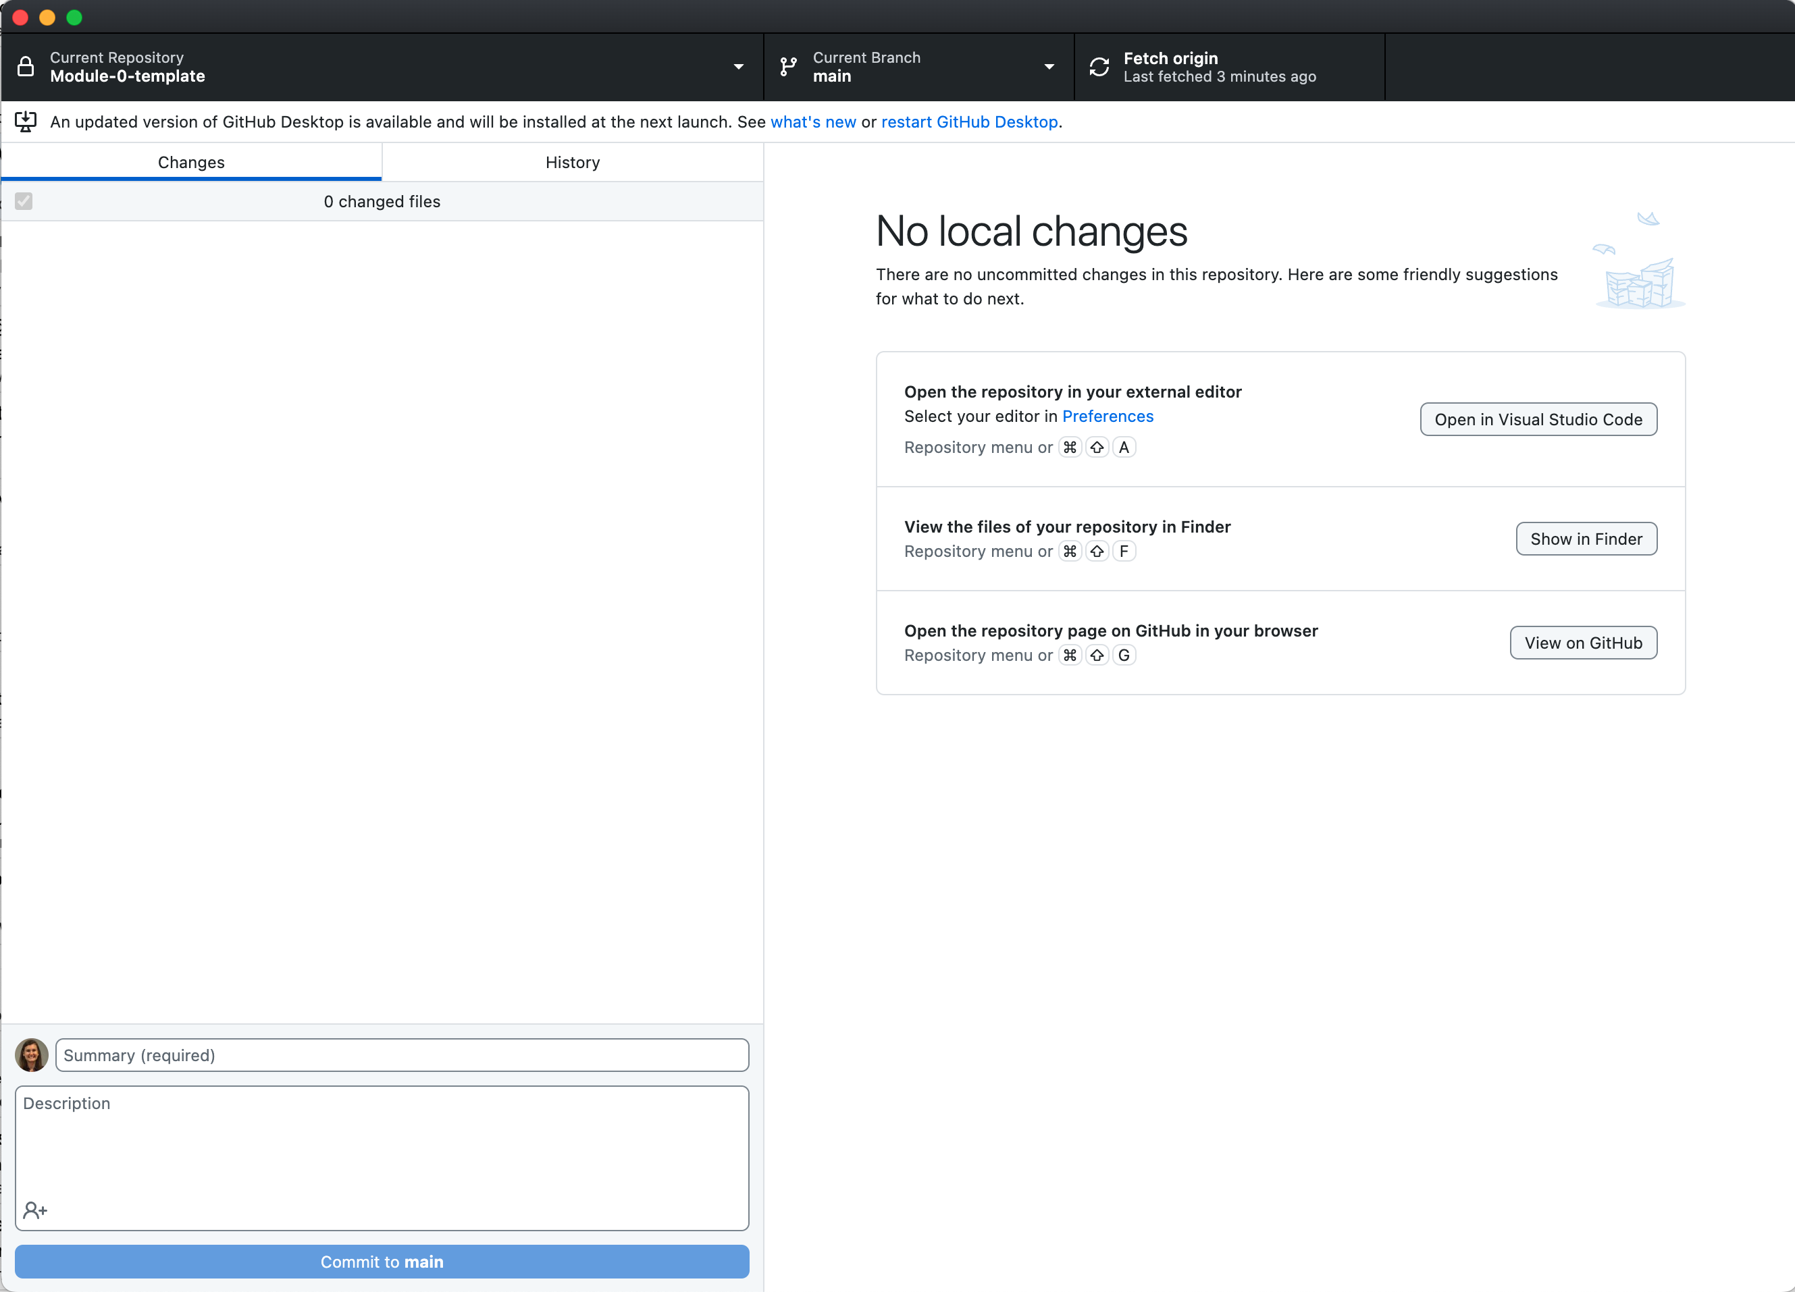
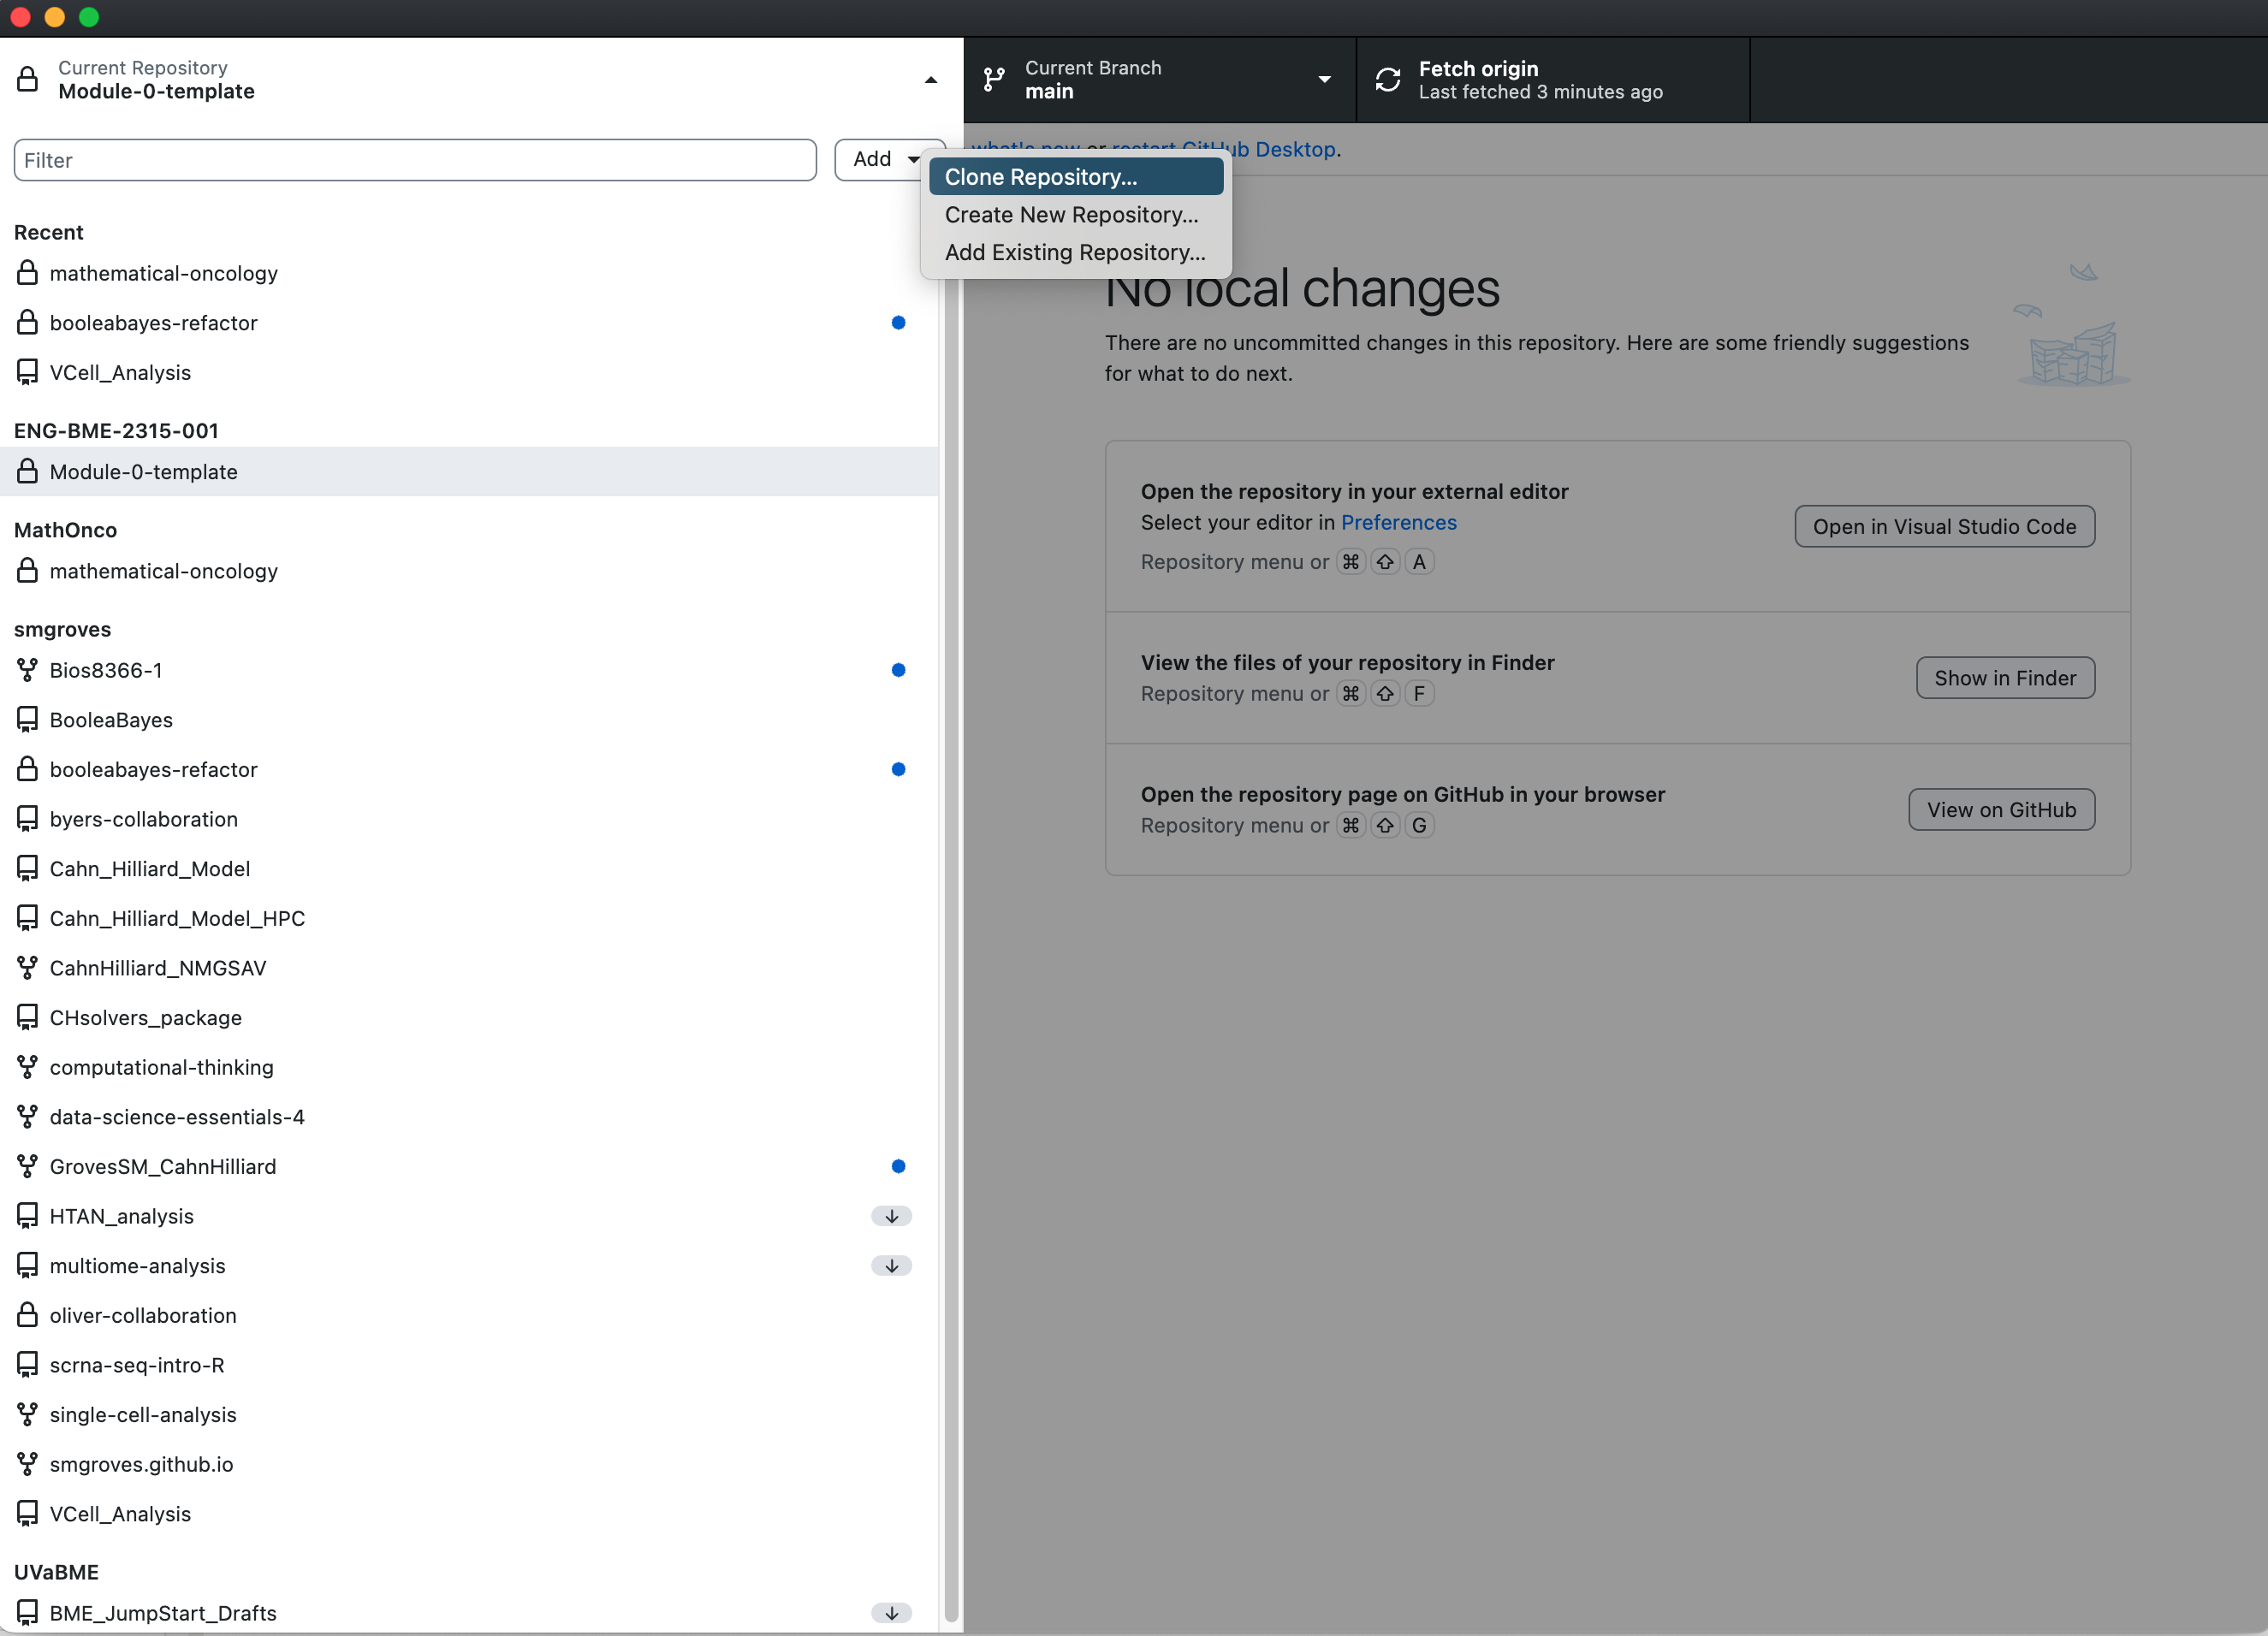
Getting set up with GitHub Desktop & git on command line
Make sure your local path is putting this new repo INSIDE the folder from last class!
Alternative in terminal:
cd /Your/folder/for/this/class
git clone https://github.com/ENG-BME-2315-001/Module-0-LastName.git
git pull origin main

Slide 12
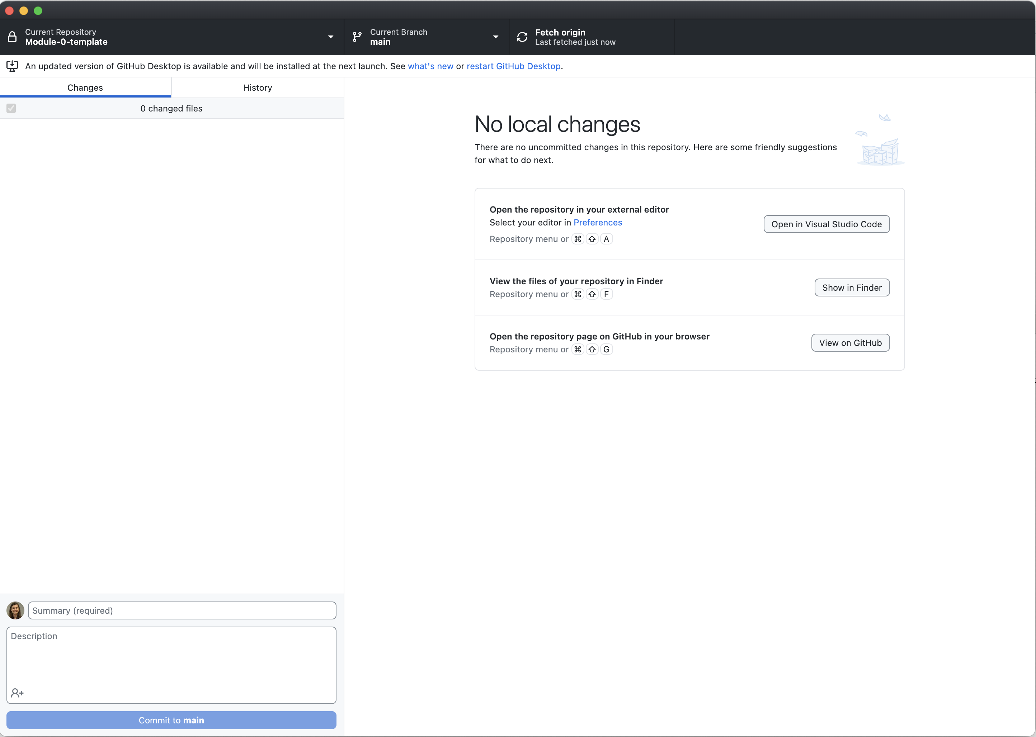
Getting set up with GitHub Desktop & git on command line
1
Fetch/pull will show up here
Local changes will show up here
History of the GitHub repo shows up here
Make sure your local path is putting this new repo INSIDE the folder from last class!
2
Open the repository locally in VS code to make changes and add files
Alternative in terminal:
cd /Your/folder/for/this/class
git clone https://github.com/ENG-BME-2315-001/Module-0-LastName.git
git pull origin main

Slide 13
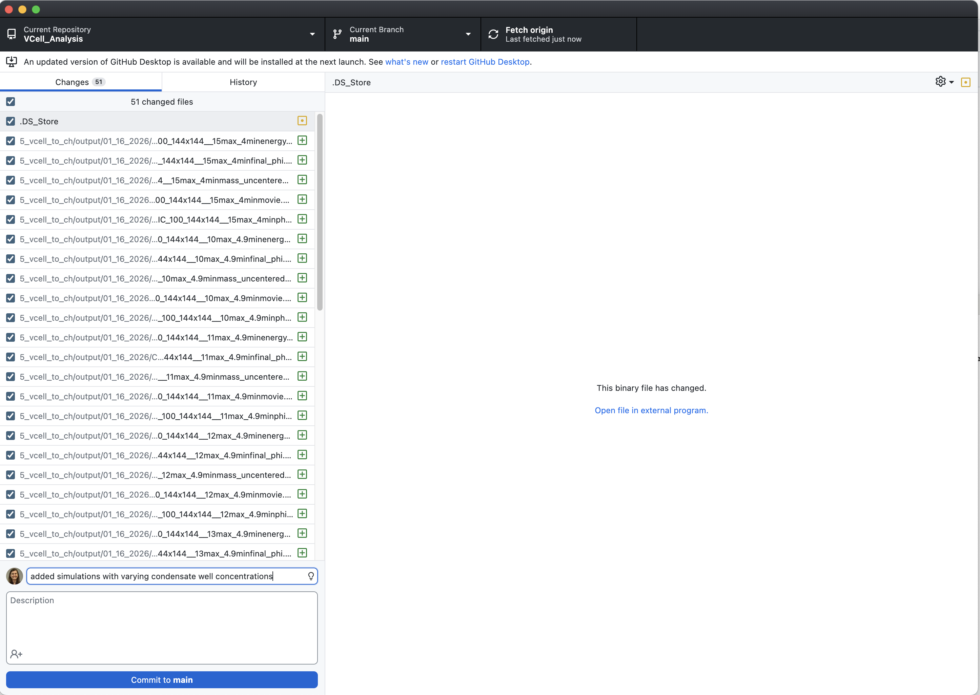
Getting set up with GitHub Desktop & git on command line
1
Fetch/pull will show up here
Local changes will show up here
History of the GitHub repo shows up here
Make sure your local path is putting this new repo INSIDE the folder from last class!
2
Open the repository locally in VS code to make changes and add files
Commit message (required)
3
Commit to current branch
Alternative in terminal:
cd /Your/folder/for/this/class
git clone https://github.com/ENG-BME-2315-001/Module-0-LastName.git
git pull origin main

Slide 14
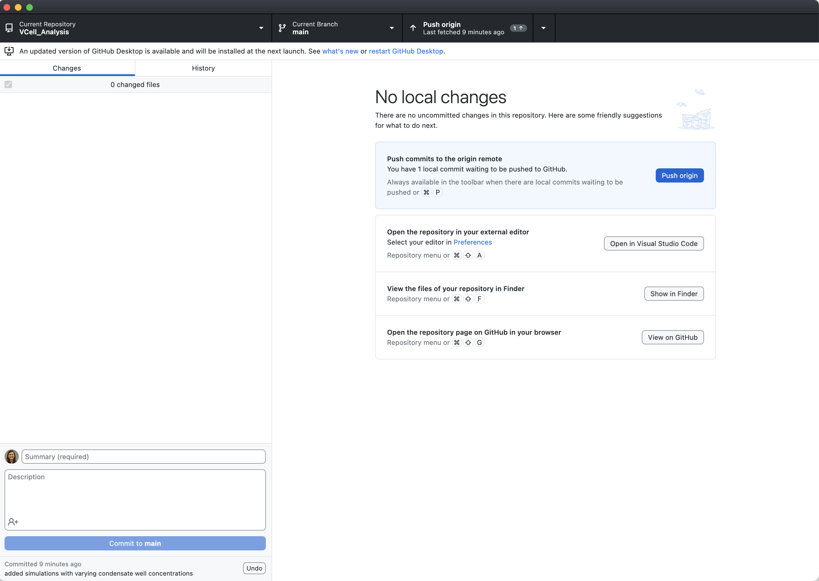
Getting set up with GitHub Desktop & git on command line
1
4
Fetch/pull will show up here
Local changes will show up here
History of the GitHub repo shows up here
Make sure your local path is putting this new repo INSIDE the folder from last class!
2
Open the repository locally in VS code to make changes and add files
Commit message (required)
3
Commit to current branch
Alternative in terminal:
cd /Your/folder/for/this/class
git clone https://github.com/ENG-BME-2315-001/Module-0-LastName.git
git pull origin main
Change your code in VS code & save
git add .
git commit –m “message for commit”
git push origin main

Slide 15
Coding Collaboratively with GitHub
Things needed today:
python_practice.py [last class]
Open github.com & log in
Thursday January 22
Dr. Groves
Dr. Peirce-Cottler
Module 0 Lecture 2
Learning objective: I know how to upload my code to GitHub, pull code from my partner, comment my code for future use, and write code reproducibly.

Slide 16
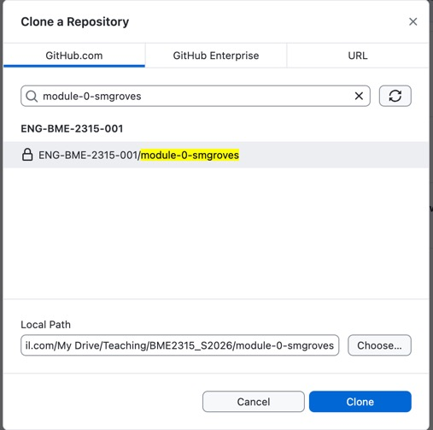
Notes from last class
If your repo doesn’t show up in GitHub Desktop, log out and log back in
Make sure the local path INCLUDES the repo name
Otherwise you will get an error that the location is not empty
My folder for this class
This repository

Slide 17
LET’S PRACTICE! Getting set up with GitHub Classroom
You should have a github account.
Join ENG-BME-2315-001 organization (from email). This will show up on your page under “Organizations”
Go to https://classroom.github.com/a/PHAtZR-G & find your name in the roster.
Accept Module_0 assignment (it should add your github username)
Find your repository by going to the ENG-BME-2315-001 organization (on your homepage) and click on the repository named “Module_0_ YourUserName” corresponding to your name.
Clone the repo to your local computer
Fetch origin/main
Open in VS Code
Update README, save, and push changes to the main branch
OR
- Add README.MD with your name/date in VS code & save
- Commit changes
- Publish branch
Stand your name card on its edge when you are done.
Help your neighbors!
If you need a TA/instructor, raise your hand!
Notes:
https://serverspace.us/support/help/git-pull-fetch-and-clone-whats-the-difference/

Slide 18
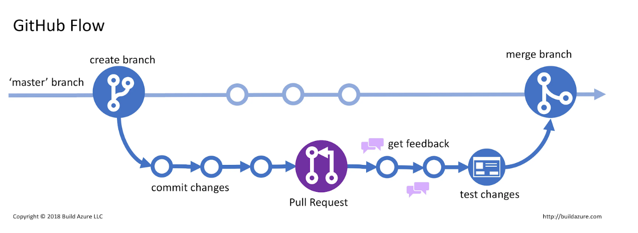
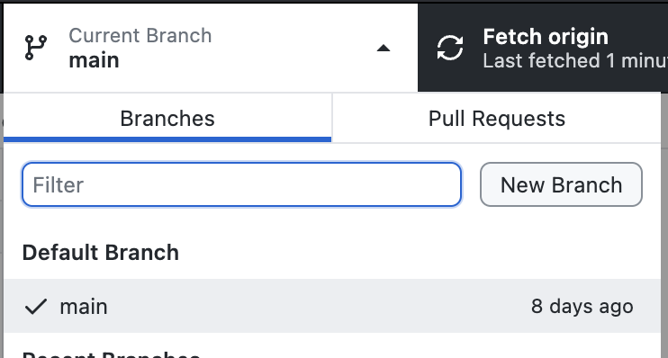
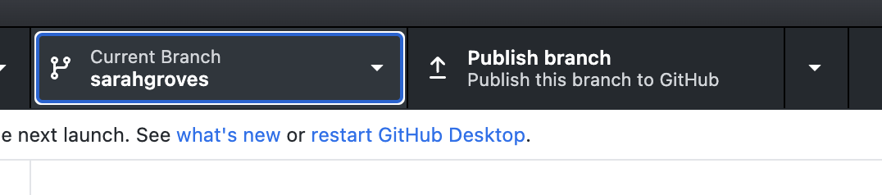
Pull Requests (PRs) and Merging: Recipe testing on a different branch
Whichever branch is “checked out” (showing in GitHub Desktop) is where your edited code will go
Once done pushing to this branch, you will make a “pull request” to merge with the main branch
Only merge when code is “done”
Don’t delete your personal branch!

Slide 19
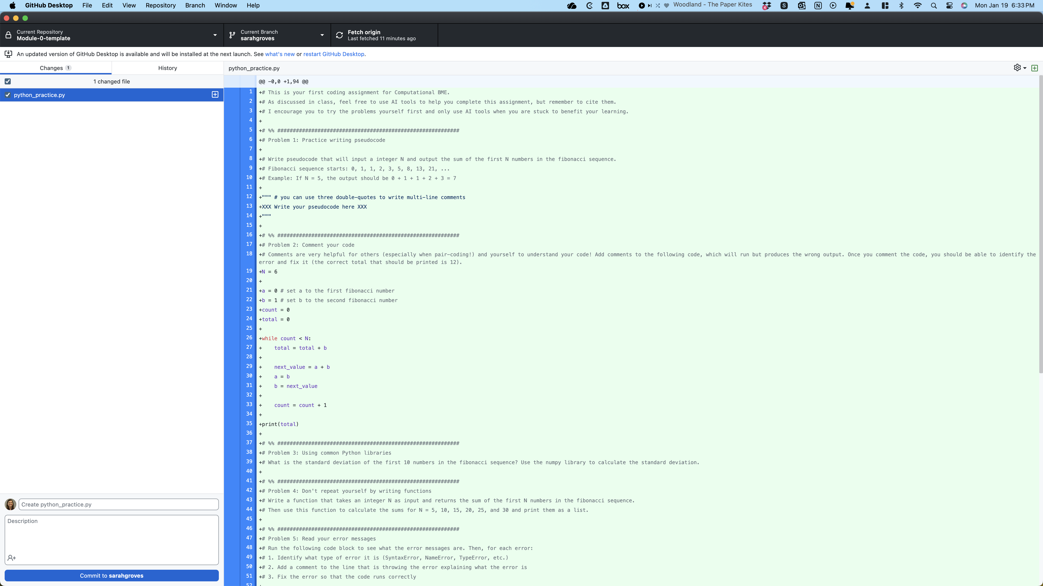
DO THIS (PULL REQUEST) WHEN CODE IS “DONE”

Slide 20
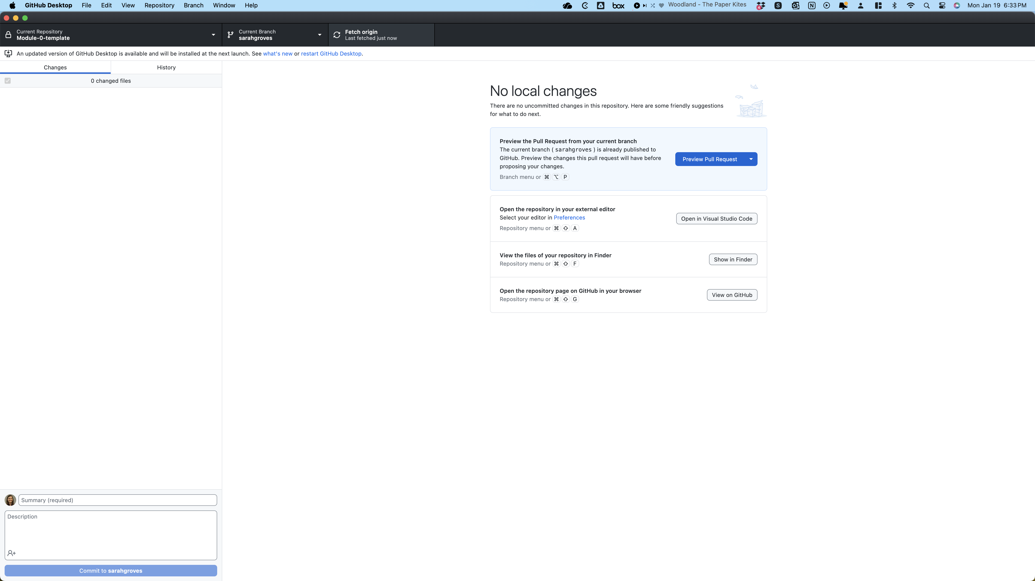
DO THIS (PULL REQUEST) WHEN CODE IS “DONE”

Slide 21
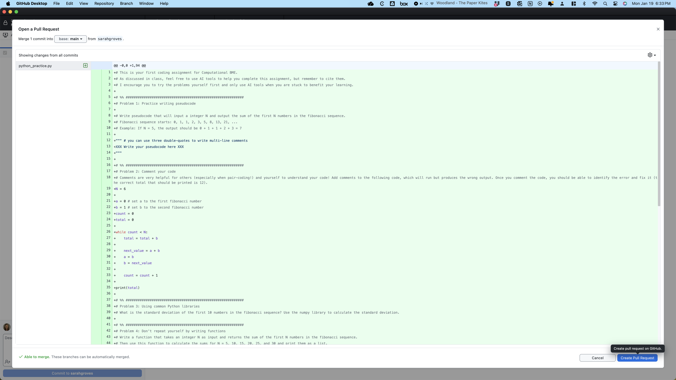
DO THIS (PULL REQUEST) WHEN CODE IS “DONE”

Slide 22
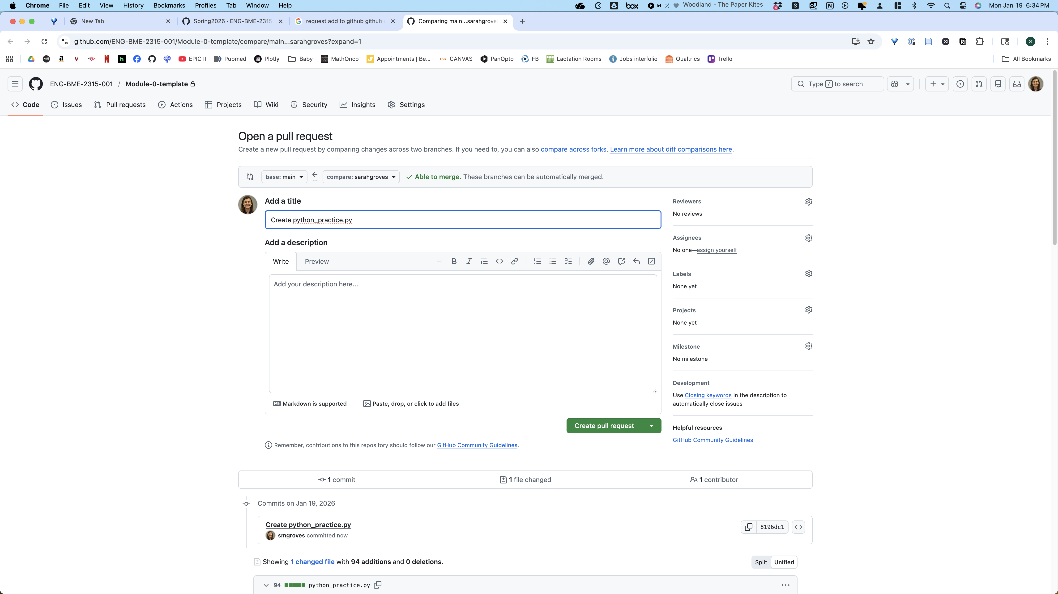
Explain what the pull request is adding
DO THIS (PULL REQUEST) WHEN CODE IS “DONE”

Slide 23
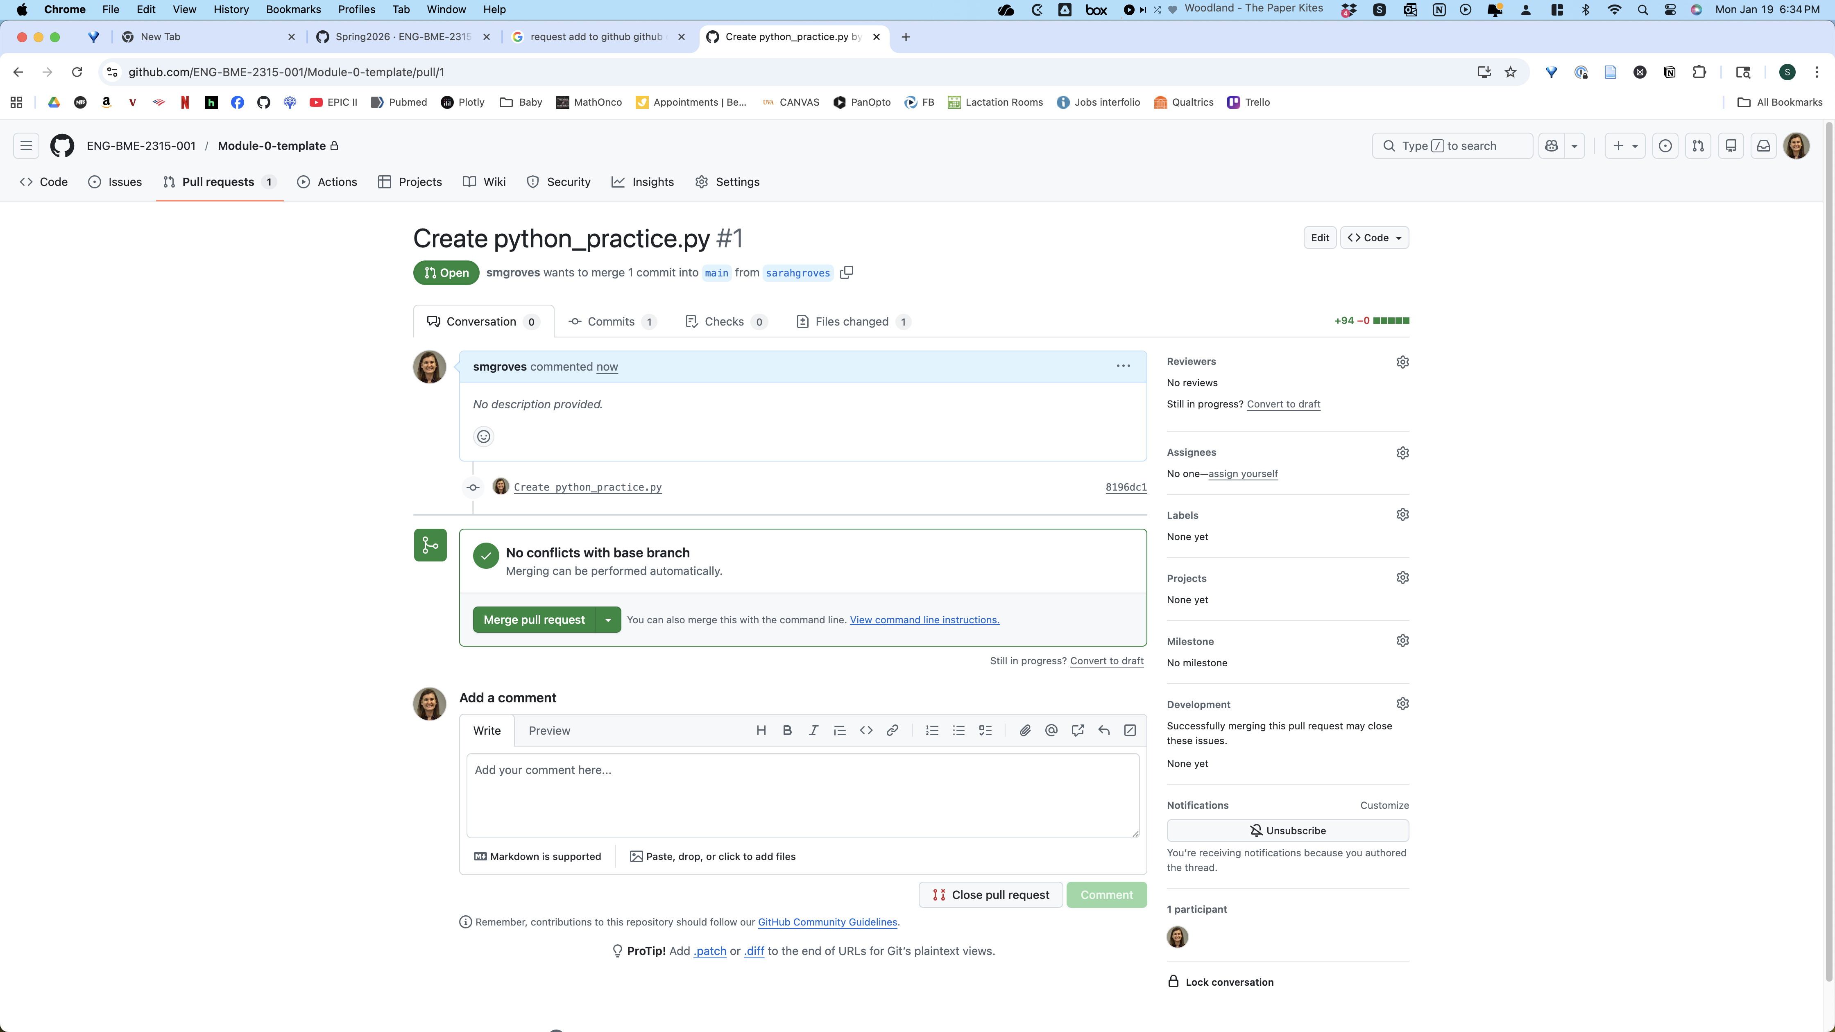
Once your partner approves, merge with main branch
Your partner can comment on your PR here if everything looks good!
DO THIS (PULL REQUEST) WHEN CODE IS “DONE”

Slide 24
How will we use GitHub in this class?
Each partner should code in their own python files (.py) that are pushed to GitHub regularly.
Jupyter Notebooks for final report can be worked on throughout the Module, but only final code should go there.
Notebooks should import functions from .py files
GitHub repository structure:
One repo for each project
Shared with your partner for that module
Each partner should have their own branch and regularly make pull requests that merge the code in their branch with the main branch

Slide 25
Let’s Practice!
Make a new branch in GitHub Desktop and switch to this branch.
Add your file from last class to your repo folder (locally) on your own branch.
Then commit & push, make a pull request, and merge changes to the main branch.
Stand your name card on its edge when you are done. Help your neighbors! If you need a TA/instructor, raise your hand!

Slide 26
Getting set up with GitHub Classroom for Pair work
You should have a github account.
Join ENG-BME-2315-001 organization. This will show up on your page under “Organizations”
Accept Module_0 assignment and set the assignment repo name by making a team (LastName1_LastName2_Company) or joining your partner’s team.
Find your repository by going to the ENG-BME-2315-001 organization (on your homepage) and click on the repository named “Module_0_LastName1_LastName2 _Company” corresponding to your pair.
Clone the repo to your local computer
Make your own LastName branch of the repo
Update README, save, and push changes to your branch
Make a pull request to the main branch and merge

Slide 27
General protocol for EVERY coding session
PULL FROM REMOTE
OPEN FOLDER LOCALLY
CODE & SAVE
COMMIT CHANGES, PUSH TO REMOTE
When you’re happy with your code, open a PULL REQUEST

Slide 28
When can GitHub be problematic?
Problem | Advice
When you work on the same code in the same file at the same time as another person | As a general rule, do not work on the same file at the same time Alternatively, always work on different files and push and pull back and forth to share code TALK TO YOUR PARTNER WHEN YOU/THEY ARE CODING
When you delete a file some one else is working on | Don’t delete files without talking to your partner first Don’t move files around without talking to your partner first
When you add a file with the same name that someone else has, and try to push them both to the remote branch | Include your first or last name in your own file names For shared files (like your final notebook), do not try to make duplicates Add clear indications to the file name for when code should be used or if it is test code or unused
When you forget to ignore certain files that you really don’t care about | Add things to .gitignore to automatically “lose track” of them
When you are trying to commit a file > GitHub’s file size limit (100Mb) | These files must remain locally on each partner’s computer to be used. You can share them through box. Add these files to .gitignore so you never accidentally push them.
When you test code that doesn’t work, but now you can’t get back to what was working | Work on the outside of the github repo then copy/paste working code into the repo Make a brand-new file (e.g. test_lastname.py) and only change code in that file, then copy/paste when it’s working into the repo Make a branch in your repository for test code Worst case scenario: git reset (advanced, ask for help if you haven’t done this before)

Slide 29
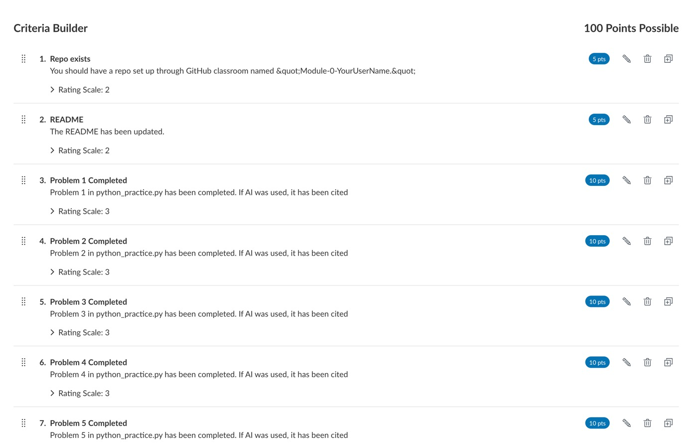

Slide 30
